Slide 1
Chapter 1
Basic Nodal and Mesh Analysis
1

Slide 2
Objectives :
Implementation of the nodal analysis
Implementation of the mesh analysis
Supernodes and Supermeshes
2

Slide 3
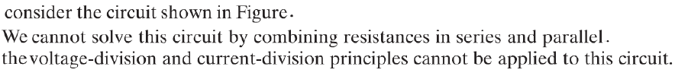
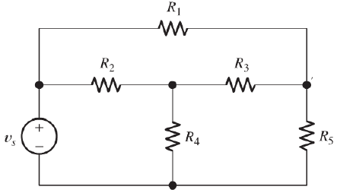
Nodal Analysis:(Node-Voltage Analysis)
3

Slide 4
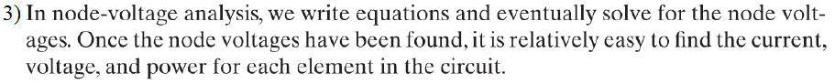
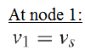
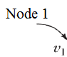
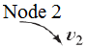
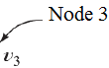
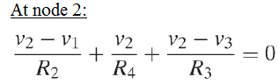
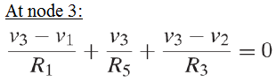
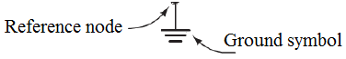
Nodal Analysis:(Node-Voltage Analysis)
4

Slide 5
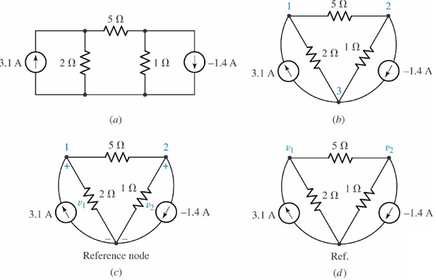
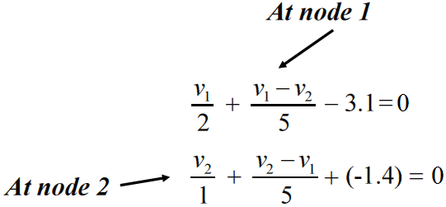
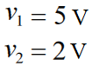
Nodal Analysis:(Node-Voltage Analysis)
Nodal Analysis: is based on KCL
Obtain values for the unknown voltages across the
elements in the circuit below.
5

Slide 6
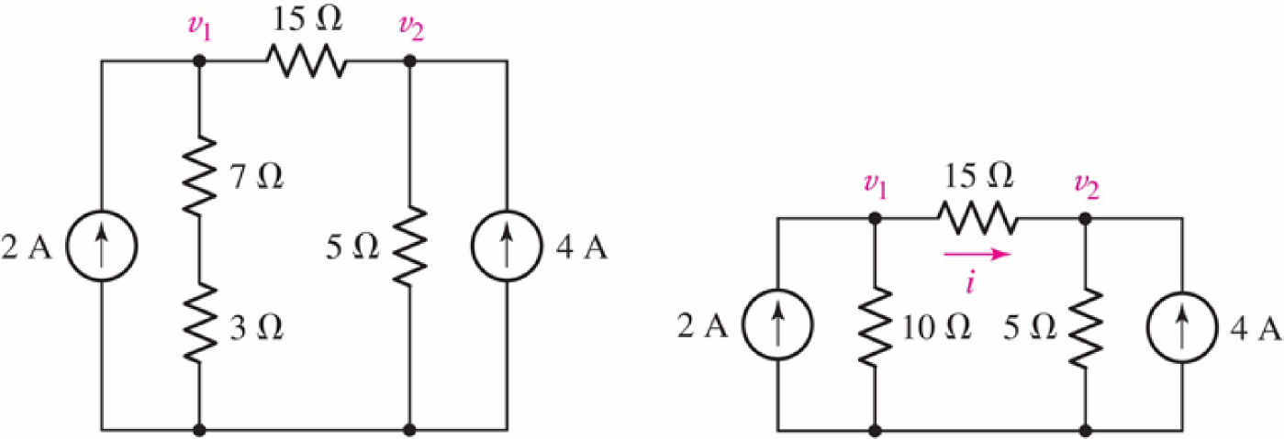
Practice:
Compute the voltage across each current source.
6

Slide 7
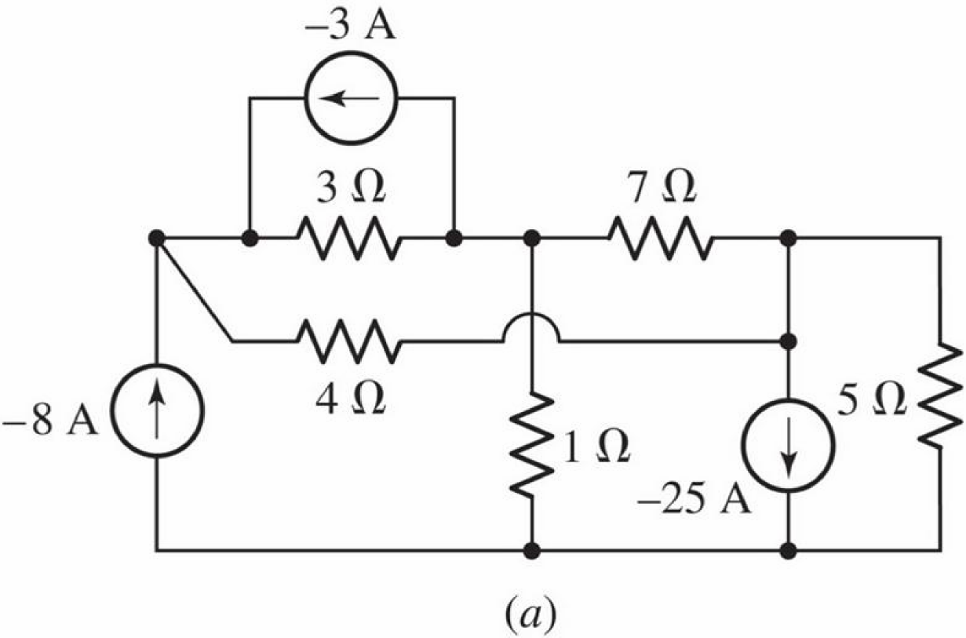
Example: 4.2
find the nodes voltages:
7

Slide 8
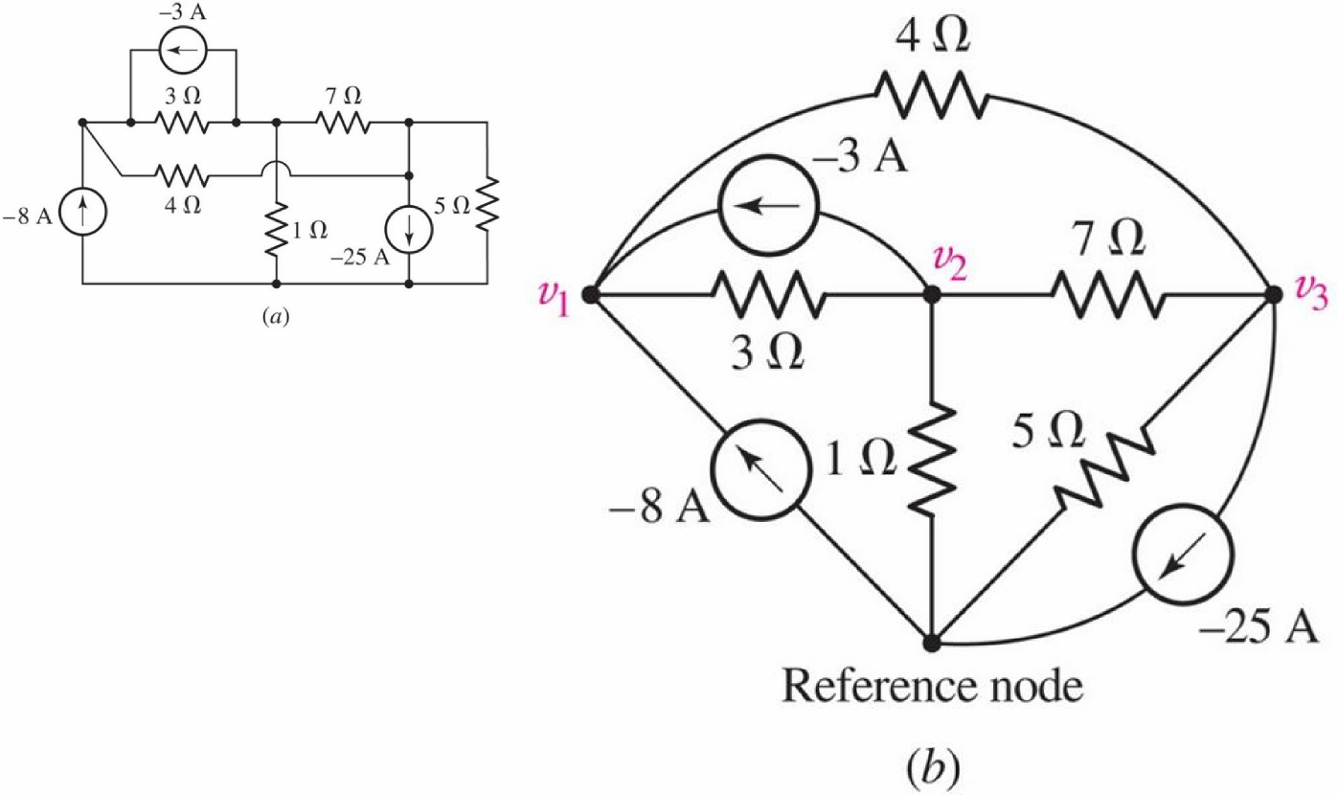
Example: 4.2
find the nodes voltages:
8

Slide 9
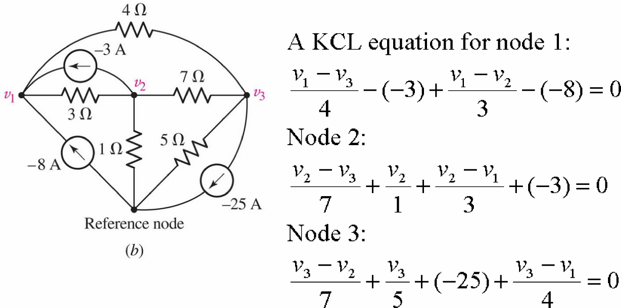
Example: 4.2
find the nodes voltages:
9

Slide 10
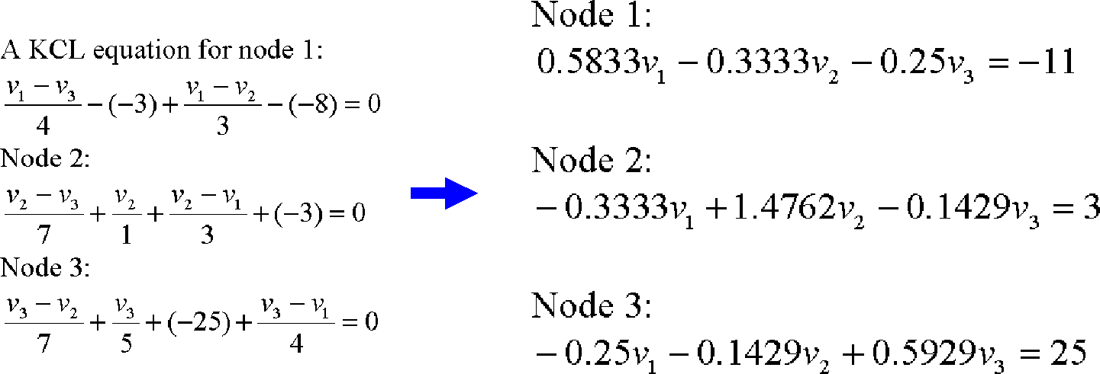
Example: 4.2
find the nodes voltages:
10

Slide 11
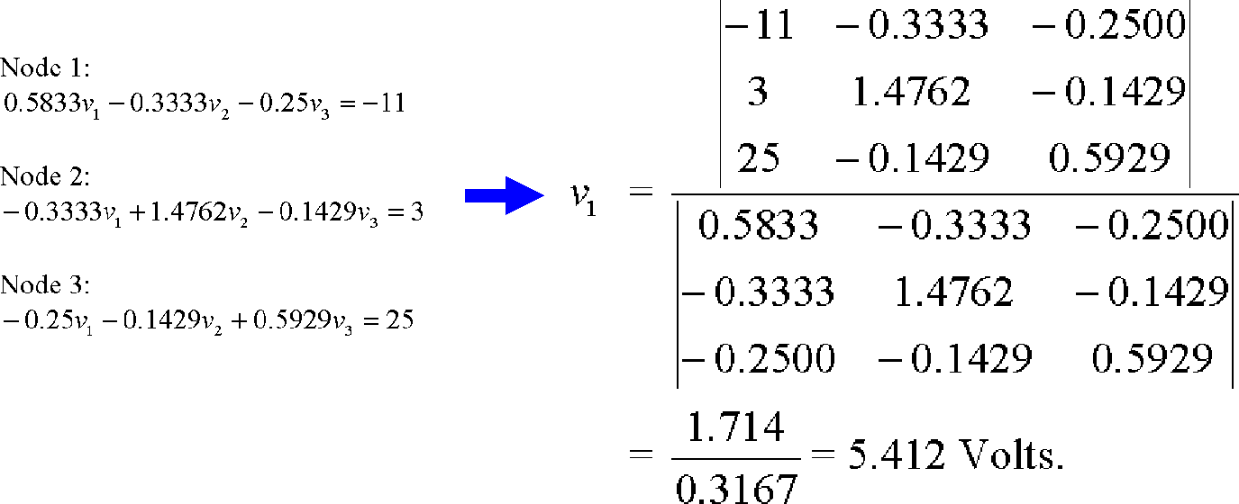
Example: 4.2
find the nodes voltages: (matrix methods)
11

Slide 12
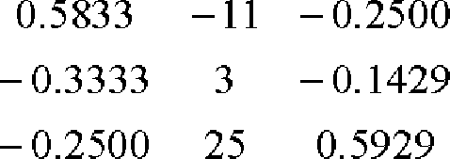
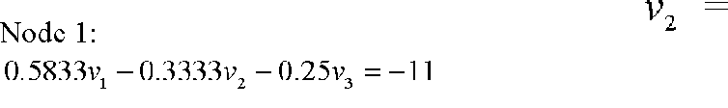
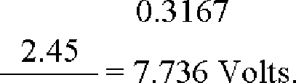
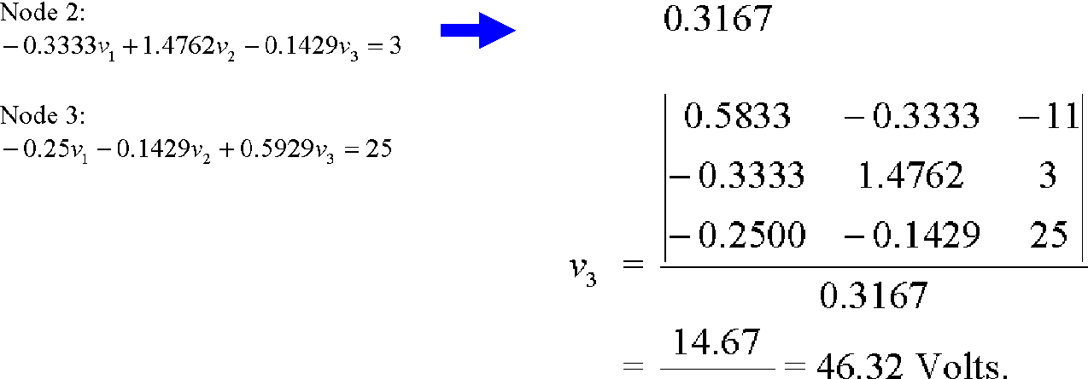
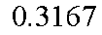
Example: 4.2
find the nodes voltages: (matrix methods)
12

Slide 13
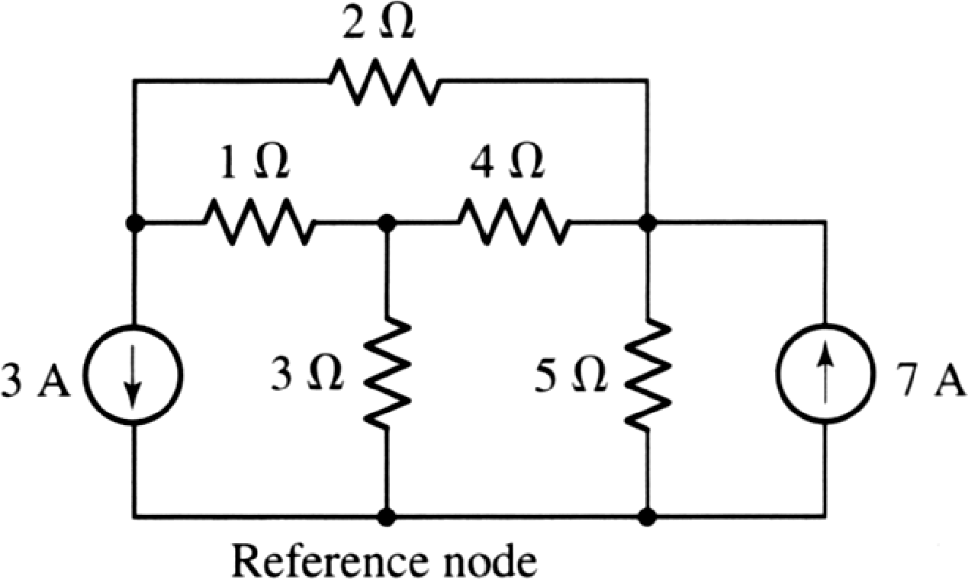
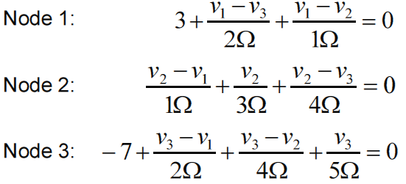
Practice: 4.2
Compute the voltage across each current source.
13

Slide 14
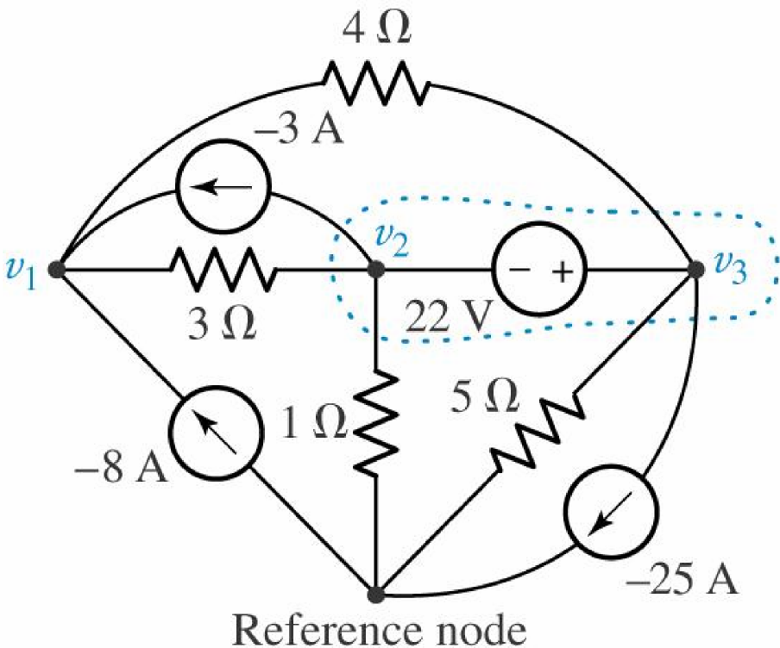
The Supernode:
find the nodes voltages:
14

Slide 15
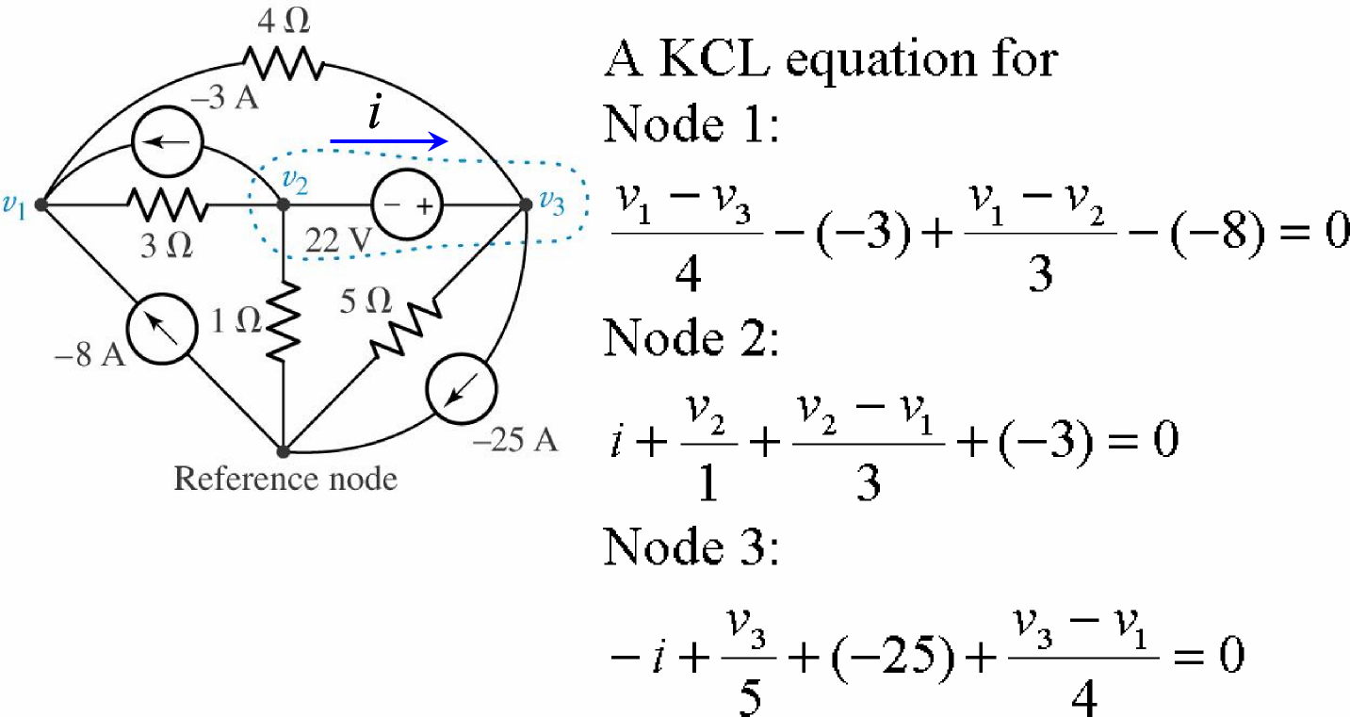
The Supernode:
find the nodes voltages:
15

Slide 16
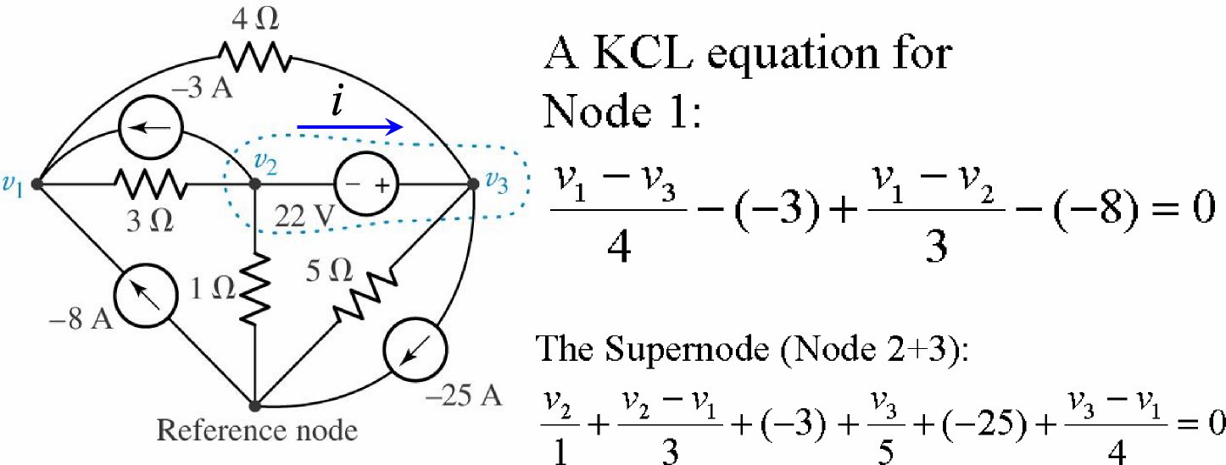
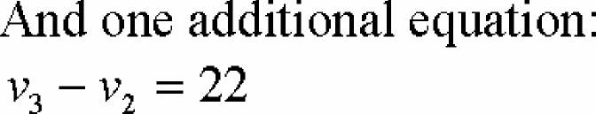
The Supernode:
find the nodes voltages:
16

Slide 17
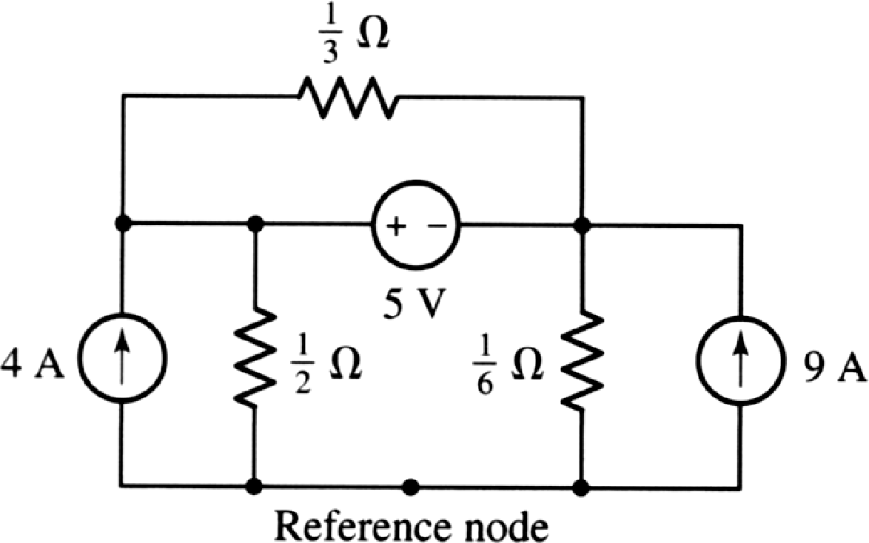
Practice: 4.4
Compute the voltage across each current source
17

Slide 18
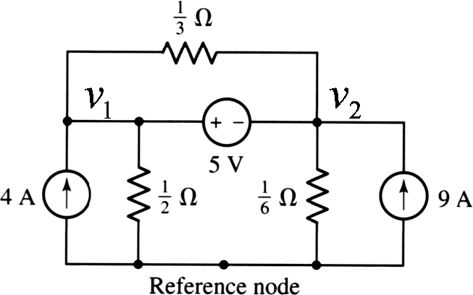
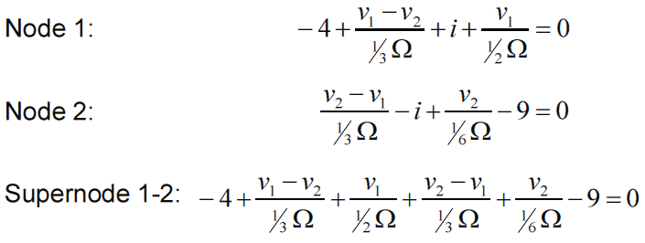
Practice: 4.4
18

Slide 19
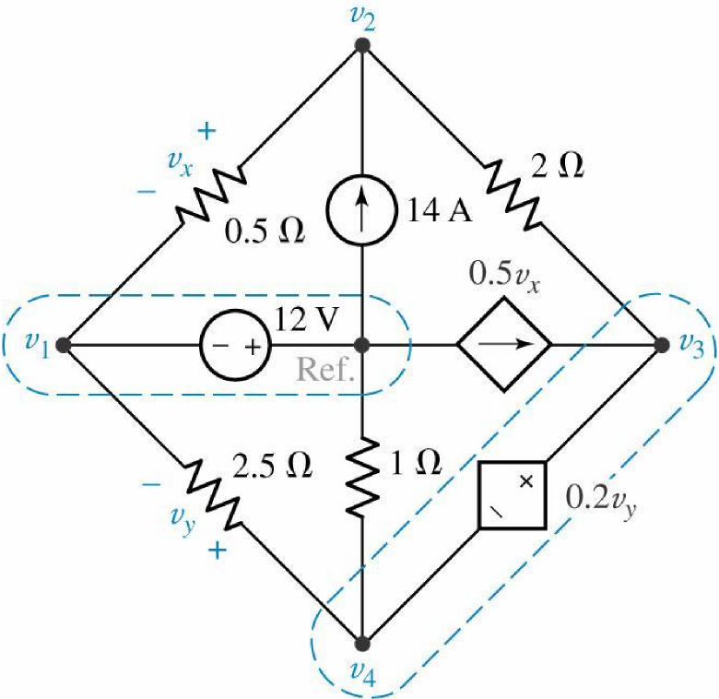
Example: 4.6
Determine the node-to-reference voltages in the circuit below.
19

Slide 20
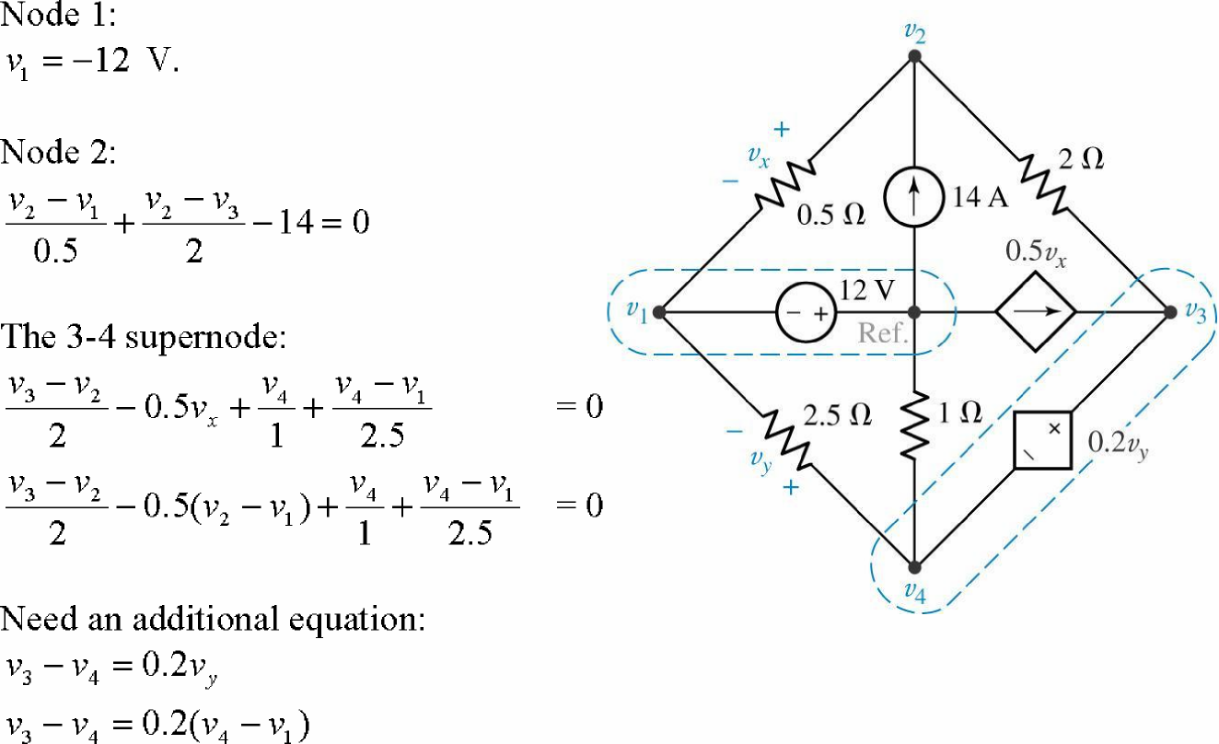
Example: 4.6
Determine the node-to-reference voltages in the circuit below.
20

Slide 21
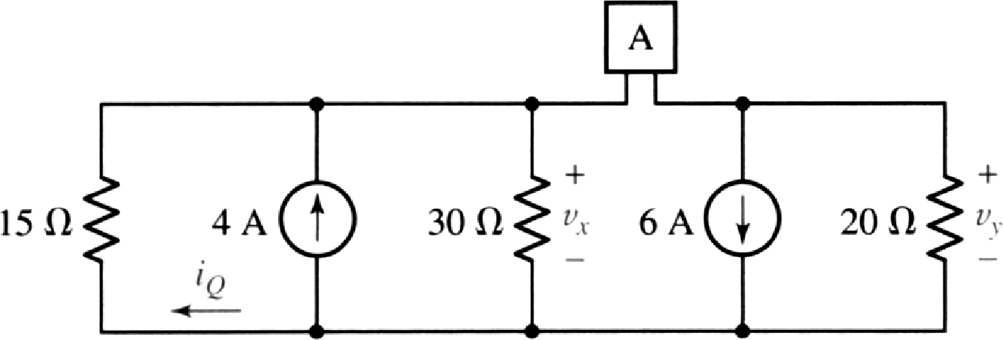
Practice:
Use nodal analysis to find v_{x}, if element A is (a)
a 25 Ω; (b) a 5-A current source, arrow pointing
right; (c) a 10-V voltage source, positive
terminal on the right; (d) a short circuit
21

Slide 22
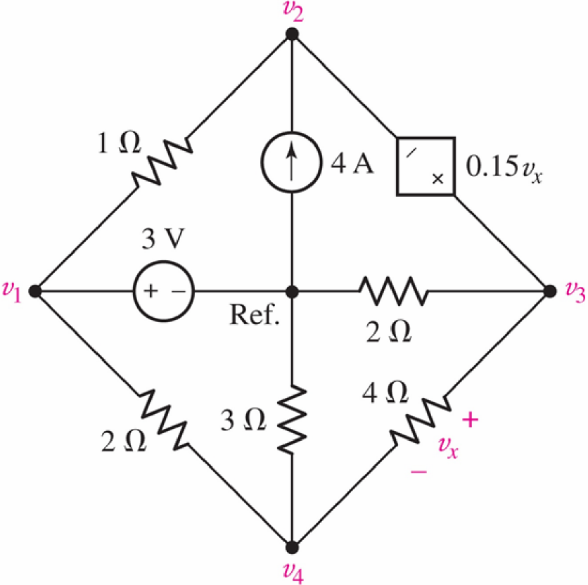
Practice:4.5
Use nodal analysis to determine the nodal
voltage in the circuit.
22

Slide 23
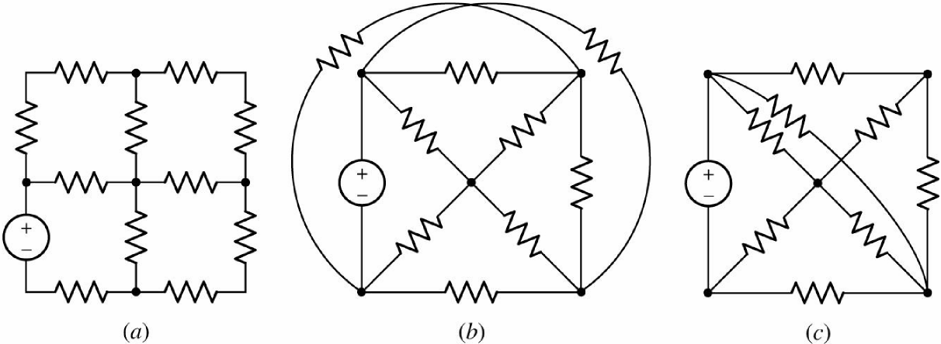
Mesh Analysis:(Mesh-Current Analysis)
Mesh analysis is applicable only to those
networks which are planar.
Examples of planar and nonplanar networks
Mesh is a loop that doesn’t contain any other loops.
23

Slide 24
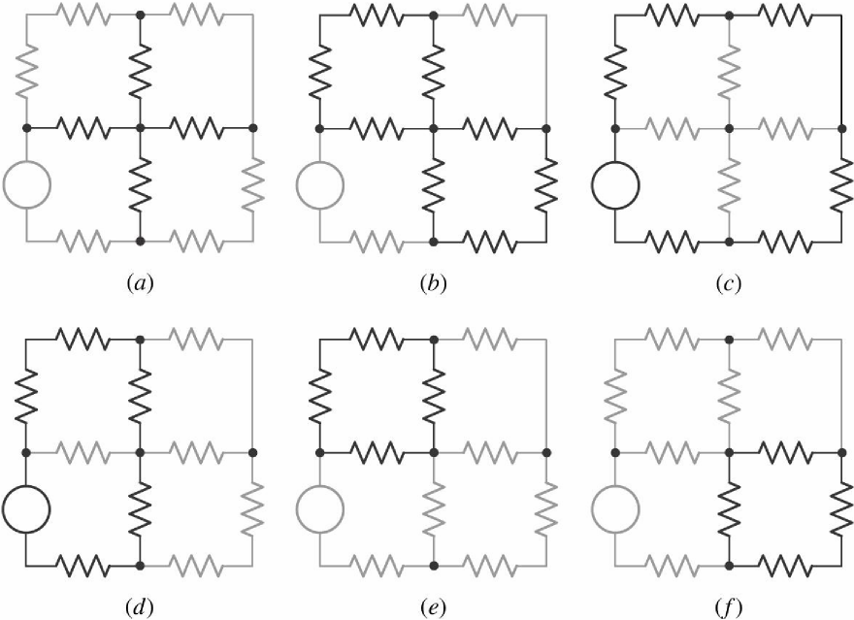
Path, Closed path, and Loop:
(a) The set of branches identified by the heavy lines is neither a path nor a
loop. (b) The set of branches here is not a path, since it can be traversed
only by passing through the central node twice. (c) This path is a loop but
not a mesh, since it encloses other loops. (d) This path is also a loop but
not a mesh. (e, f) Each of these paths is both a loop and a mesh.
24

Slide 25
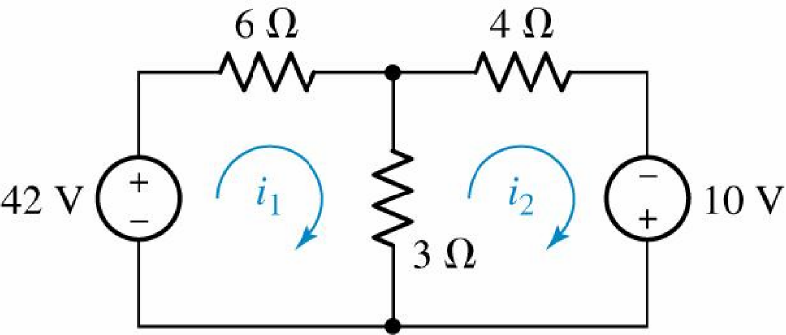
Example: 4.6
Determine the two mesh currents, i1 and i2, in the circuit below.
For the left-hand mesh,
-42 + 6 i1 + 3 ( i1 - i2 ) = 0 For the right-hand mesh,
3 ( i2 - i1 ) + 4 i2 - 10 = 0 Solving, we find that i1 = 6 A and i2 = 4 A.
(The current flowing downward through the 3- resistor is therefore i1 - i2 = 2 A. )
25

Slide 26
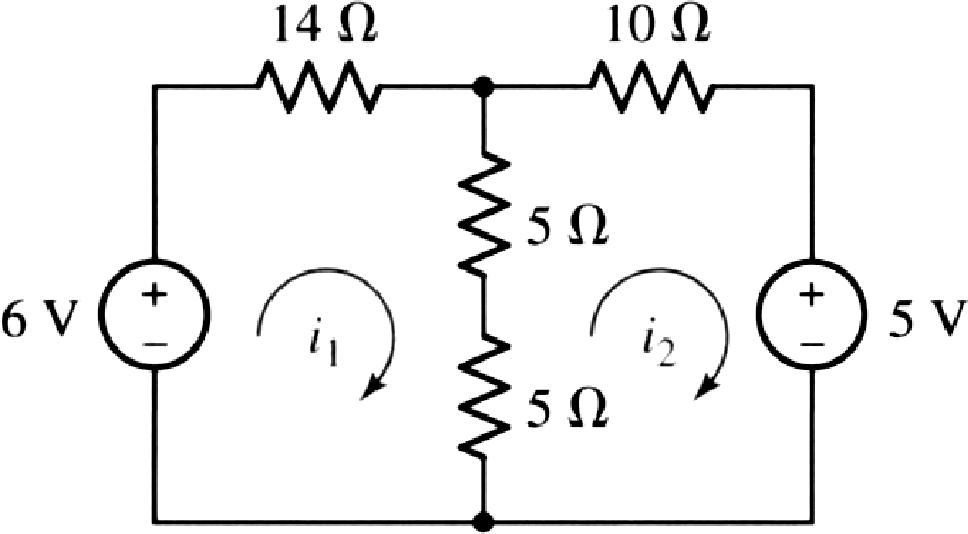
Practice: 4.6
Determine i1 and i2
26

Slide 27
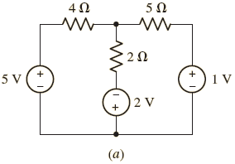
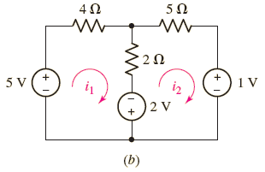
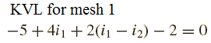
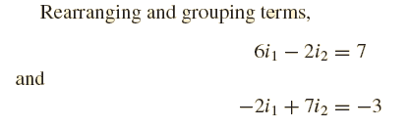
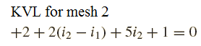
Example: 4.7
Determine the power supplied by 2V source:
27

Slide 28
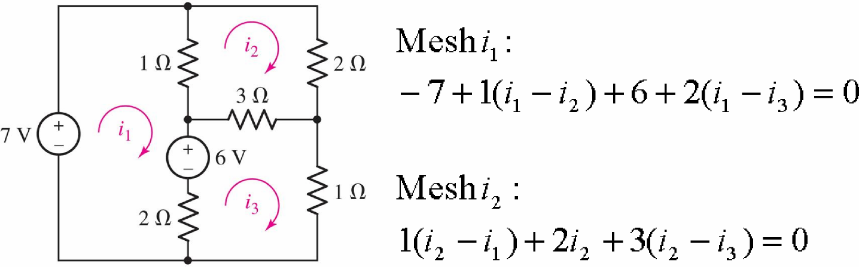
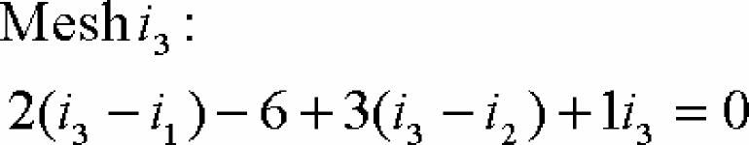
Example: 4.8
determine the three mesh currents
28

Slide 29
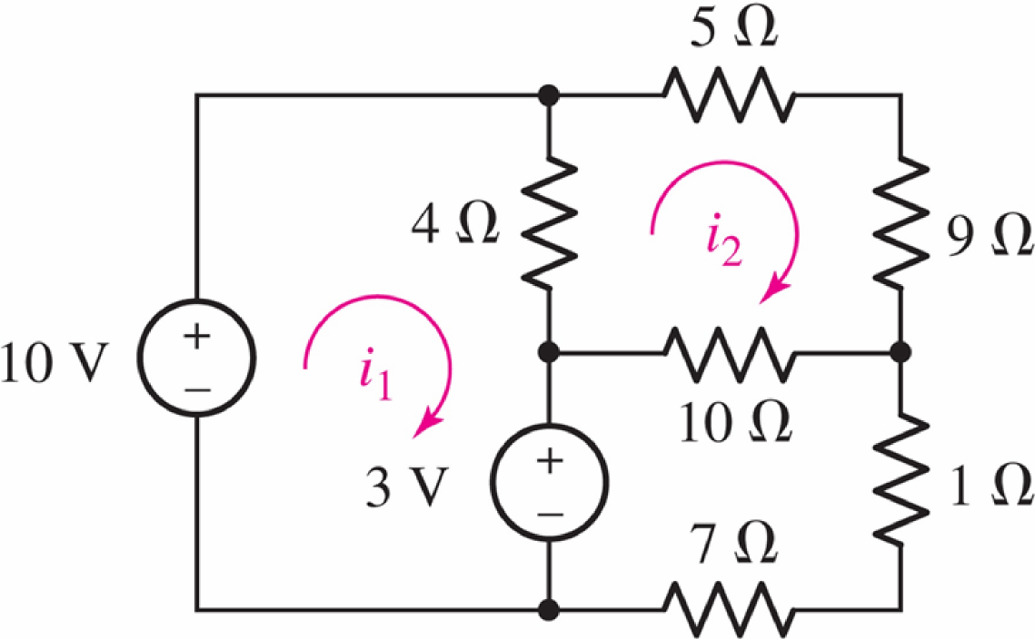
Practice: 4.7
Determine i1 and i2
29

Slide 30
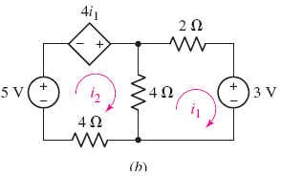


Example: 4.9
Determine in the circuit
30

Slide 31

The Supermesh:
Find the three mesh currents in the circuit below.
31

Slide 32


The Supermesh:
Find the three mesh currents in the circuit below.
32

Slide 33


The Supermesh:
33

Slide 34

The Supermesh: Page 27
The Supermesh:
Find the three mesh currents in the circuit below.
Creating a “supermesh” from meshes 1 and 3:
-7 + 1 ( i1 - i2 ) + 3 ( i3 - i2 ) + 1 i3 = 0 [1]
Around mesh 2:
1 ( i2 - i1 ) + 2 i2 + 3 ( i2 - i3 ) = 0 [2]
Finally, we relate the currents in meshes 1 and 3: i1 - i3 = 7 [3]
Rearranging,
i1 - 4 i2 + 4 i3 |  | = | 7
-i1 | + 6 i2 - 3 i3 | = | 0
i1 | - i3 | = | 7
Solving,
i1 = 9 A, i2 = 2.5 A, and i3 = 2 A.
34

Slide 35

Practice: 4.10
Find the voltage v3 in the circuit below.
35

Slide 36

A comparison:
36

Slide 37

A comparison:
37

Slide 38


A comparison:
38

